Slide 1
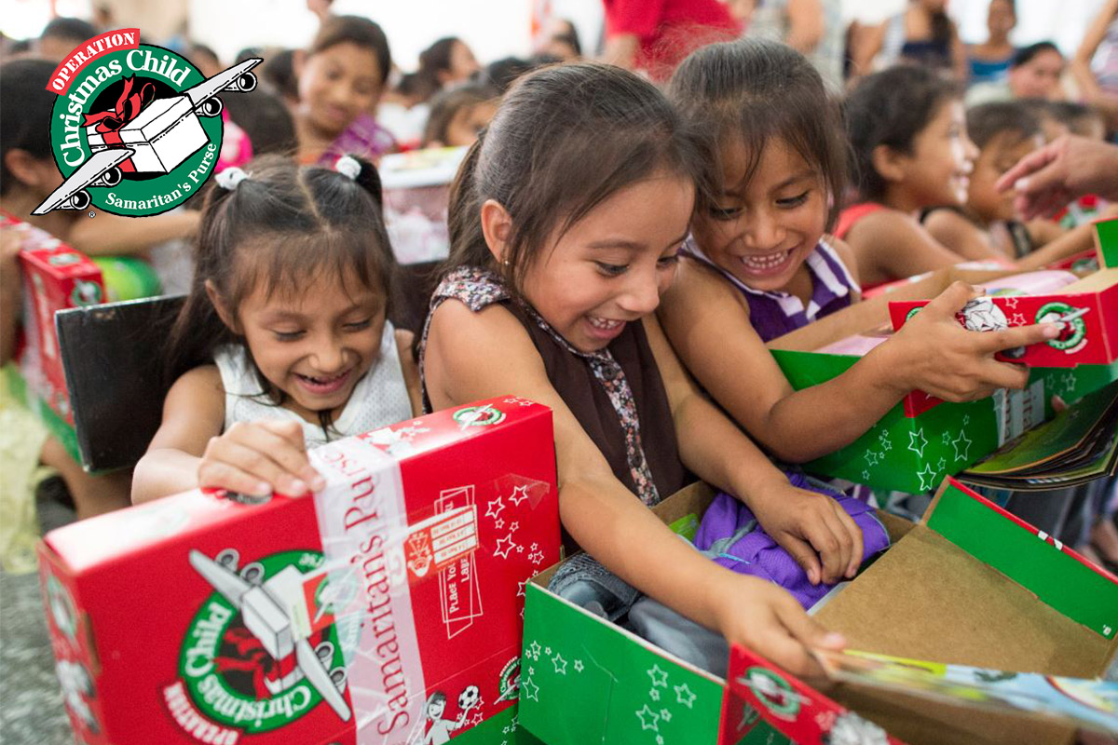
The Christmas Shoe Box Appeal!

Slide 3
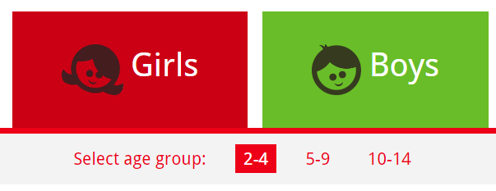
When? You must have donated by Monday 20th November 2022 – No time to waste!
Where? Please bring all donations to the collection point outside of my classroom (6B)
What? An empty Christmas wrapped shoebox, a donation that will fit inside a shoe box, a letter or card to a child who might receive the box – Please only write your first name and no personal details.
Who? Pick either a boy or a girl (or an item that would be suitable for both!) and think about the age you like to buy for.

Slide 4
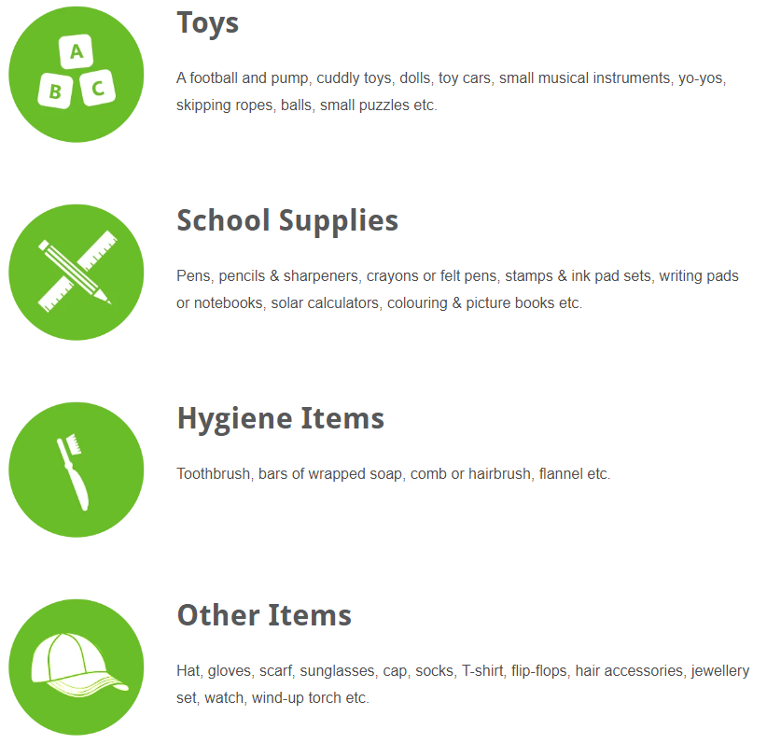
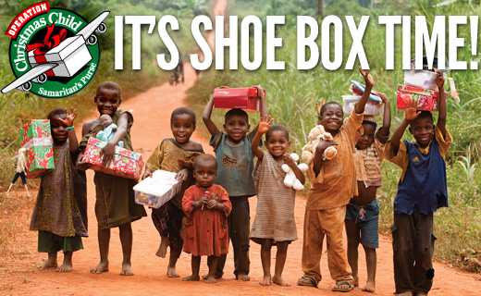
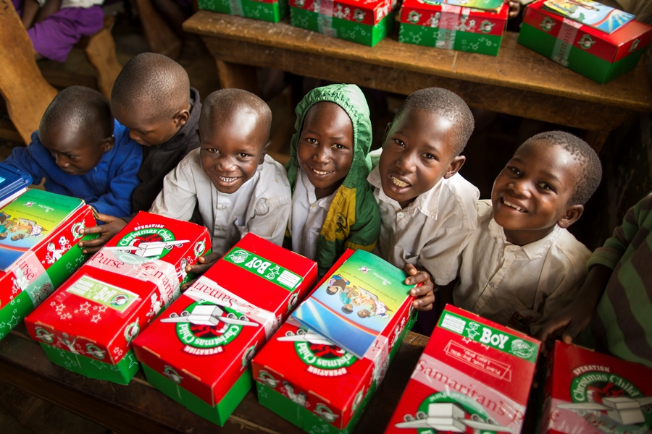

Slide 5
Visit the Samaritans Purpose Website for more ideas and information!

