Slide 1
St Modwen’s School Parliament
2022-23

Slide 2
What does parliament mean?
Parliament is the lawmaking group of the United Kingdom.
The government leader, called the prime minister, is always a member of Parliament.
These people make the decisions about how the country should be ran.

Slide 3
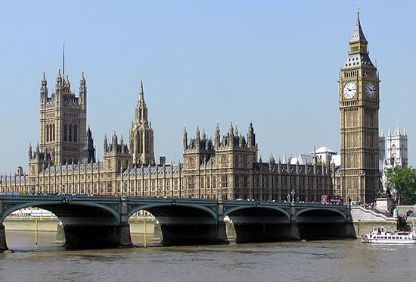
The houses of parliament stand on the left bank of the Thames River in London, England.
This is where members of parliament meet each day.

Slide 4
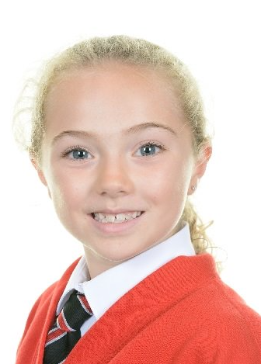
Speaker
Eva

Slide 5
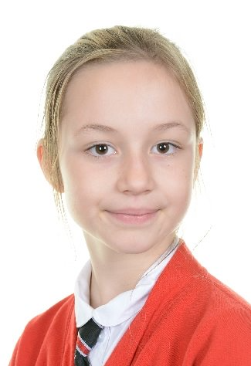
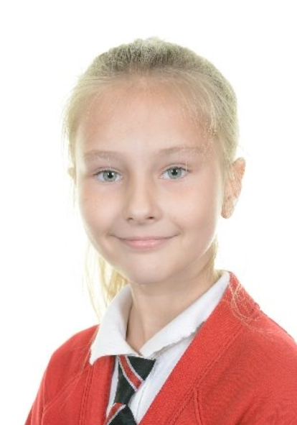
Leader
Nadia
Deputy Leader
Jessica

Slide 6
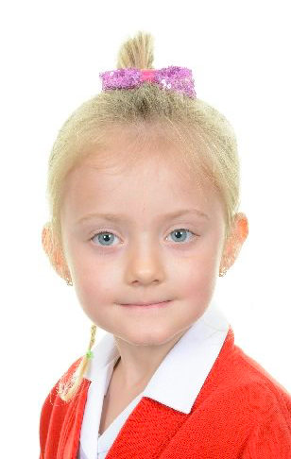
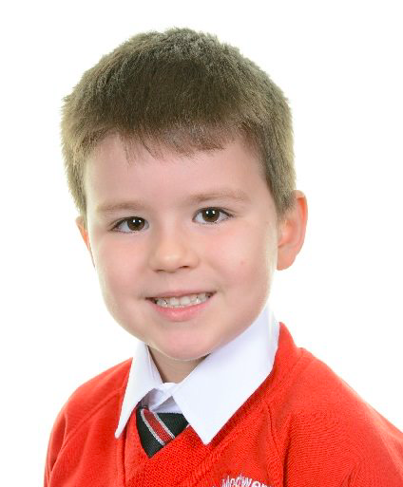
Year 1 Hanna
Year 2
Szymon

Slide 7
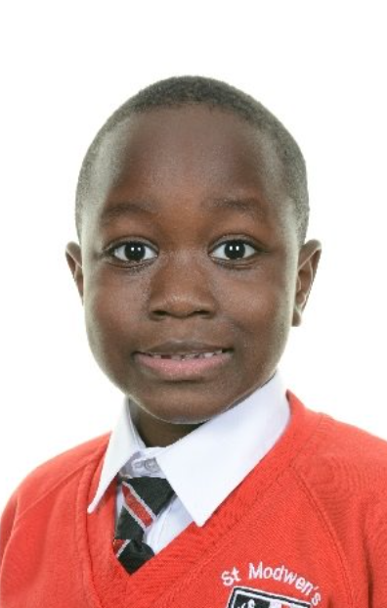
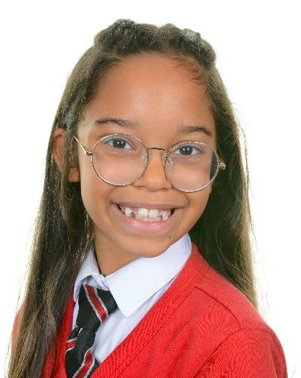
Year 3 Malachi
Year 4 Isla

Slide 8
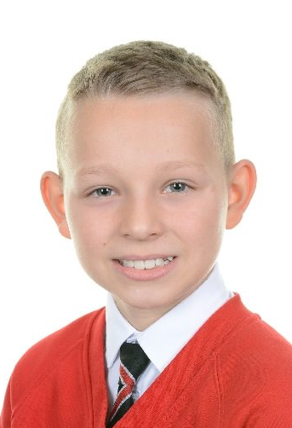
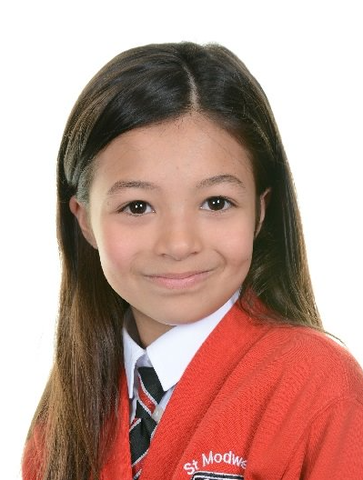
Year 5
Ariah
Year 6
Maks

Slide 9
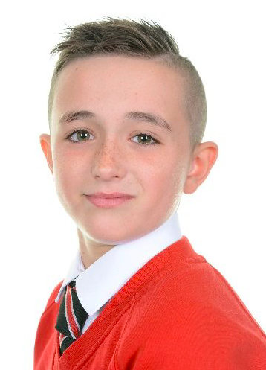
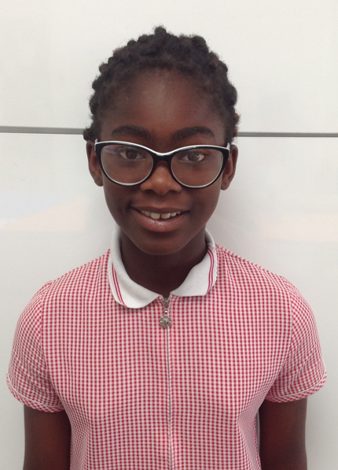
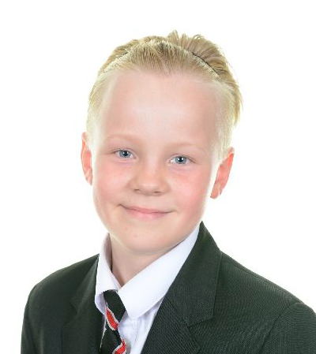
Chaplain team MP
Sports Council MP
Ivana
Rian
Eco-committee MP
Youth Mental Health MP
Charlie
Zara

Slide 10
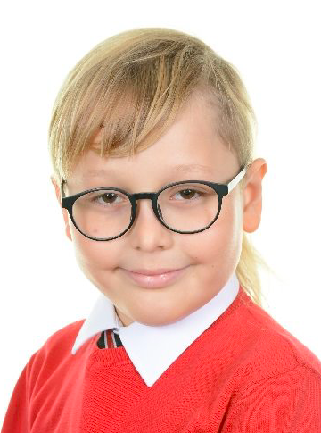
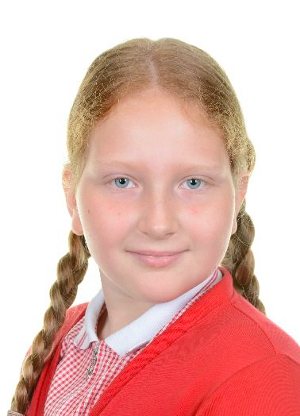
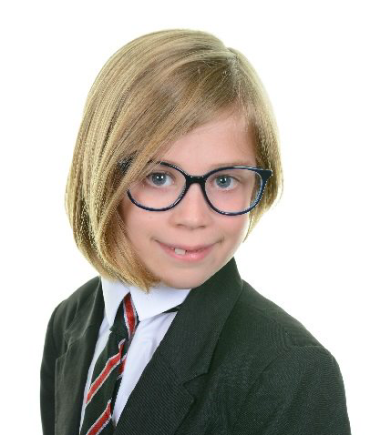
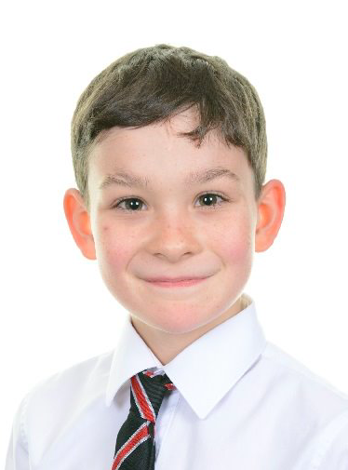
Nathaniel
Digital Leader MP
Librarian MP
Maja
Phunky Foods MP
Chancellor (Maths Champion)
Joni
Haydn

Slide 11
St Modwen’s School Parliament

